Slide 1


Project Team_Moon
Mental Health - Anxiety 2020

Slide 2
Outline
Topic Overview
Data Source
Scope of the Project
Data Discovery
Analysis and Findings

Slide 3
Topic Overview

Slide 4
Topic
Mental health care access with a focus on those with a diagnosis with anxiety.

Slide 5
Mental Health - Anxiety
[SPECIFIC TYPE OF] machine learning was used to classify which underlying attributes contribute to predicting an anxiety diagnosis.
The topic will additionally focus on the year of 2020 and look at the demographics of mental health factors such as, race, gender, age, state.
The topic was chosen due to the relevance it has on today’s society.

Slide 6
Scope of the Project
1

Slide 7
The driving questions for this analysis were:
What factors about a patient increase their likelihood of being diagnosed with anxiety disorders?
Are anxiety diagnoses more prevalent in certain areas of the country, or across certain demographic groups?
What states are more likely to have higher rates of mental health issues in relation to population?
What is the gender breakdown of mental health by state, region or division?

Slide 8
Data Discovery
The data was gathered from the Substance Abuse and Mental Health Data Archive (SAMHDA). They are one of the leading sources for behavioral health data in the United States. We were able to find data from 2013 - 2020. As a team we settled on 2020, as it was the most relevant timeframe.
The data provided was over 6 million line items and covered many areas of mental health diagnosis and demographics. As an item of note, we found it interesting that marital status was a hard topic to admit too. 43% of the participants were never married, 42% Unknown and only 15% admitted to being either married, separated , divorced or widowed.

Slide 9
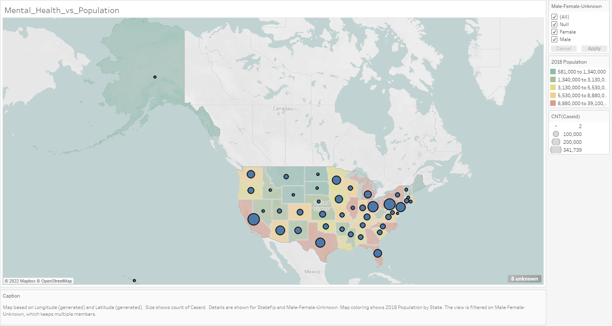

Slide 10
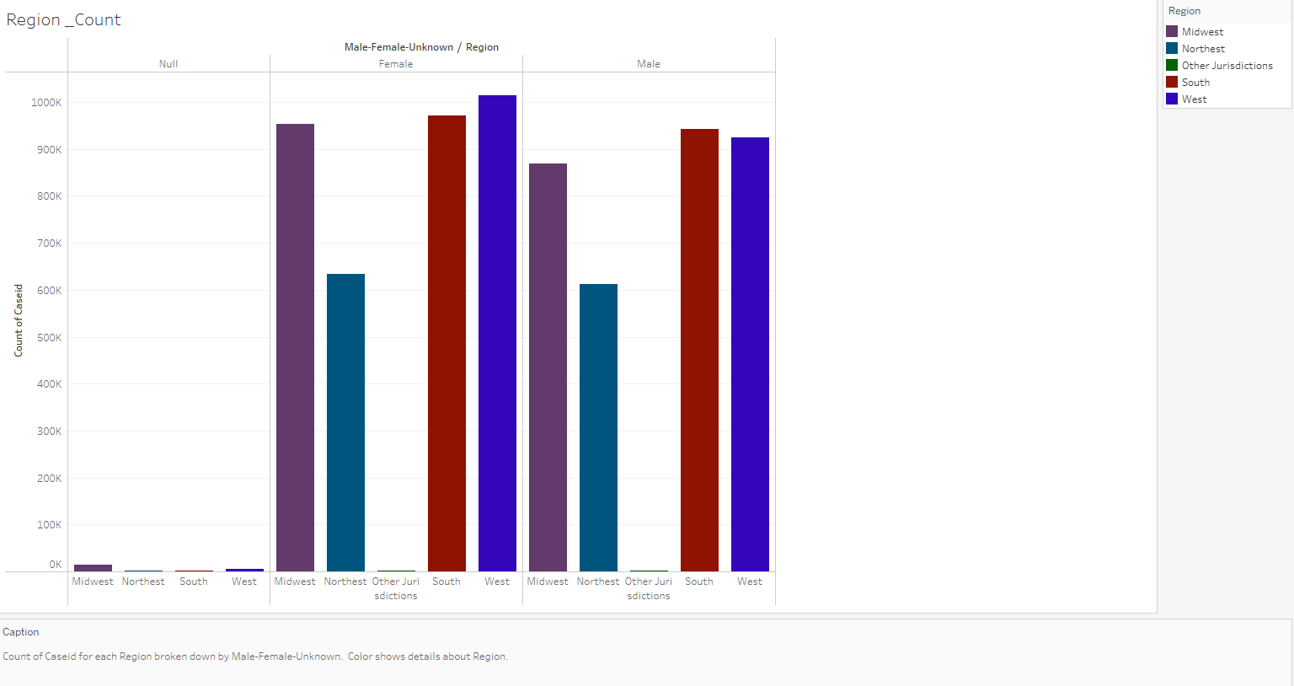

Slide 11
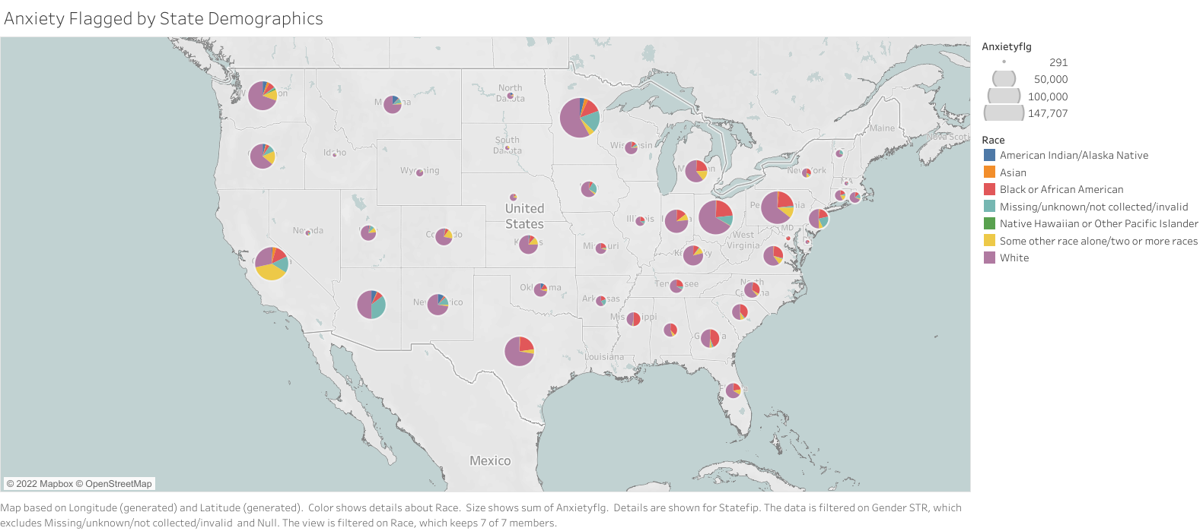
https://public.tableau.com/shared/4S6CKB8RY?:display_count=n&:origin=viz_share_link

Slide 12
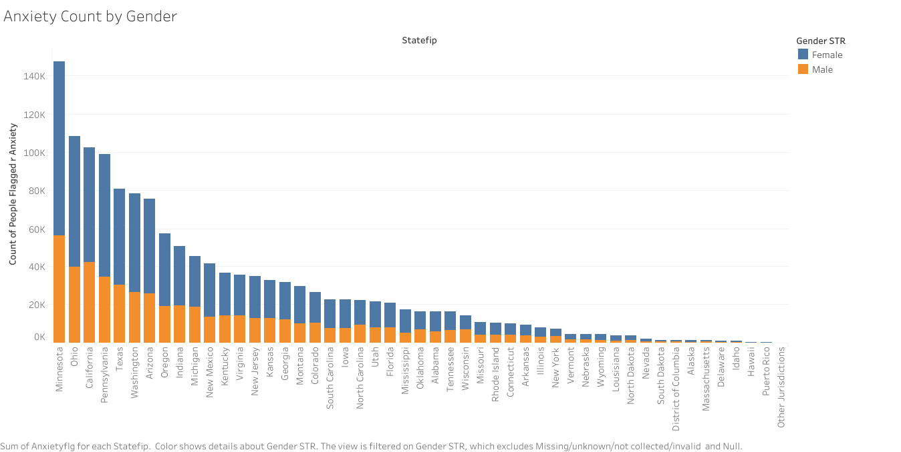
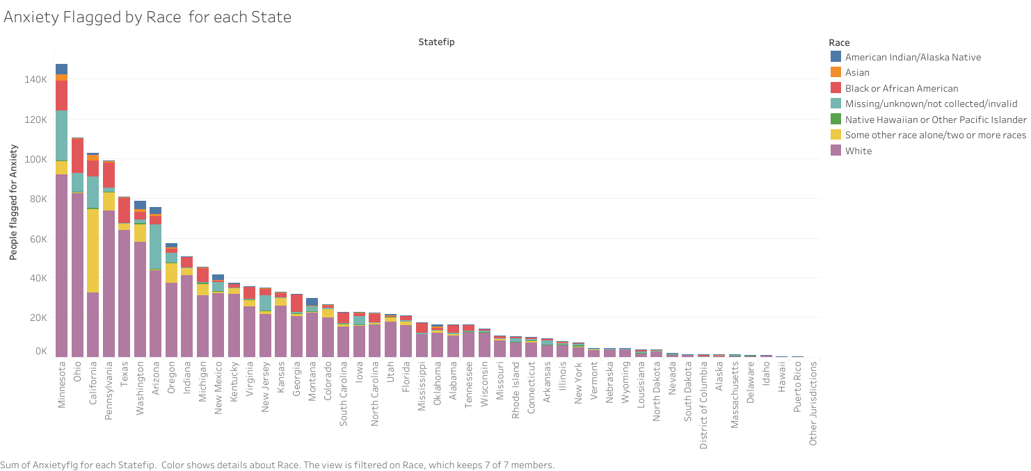

Slide 14
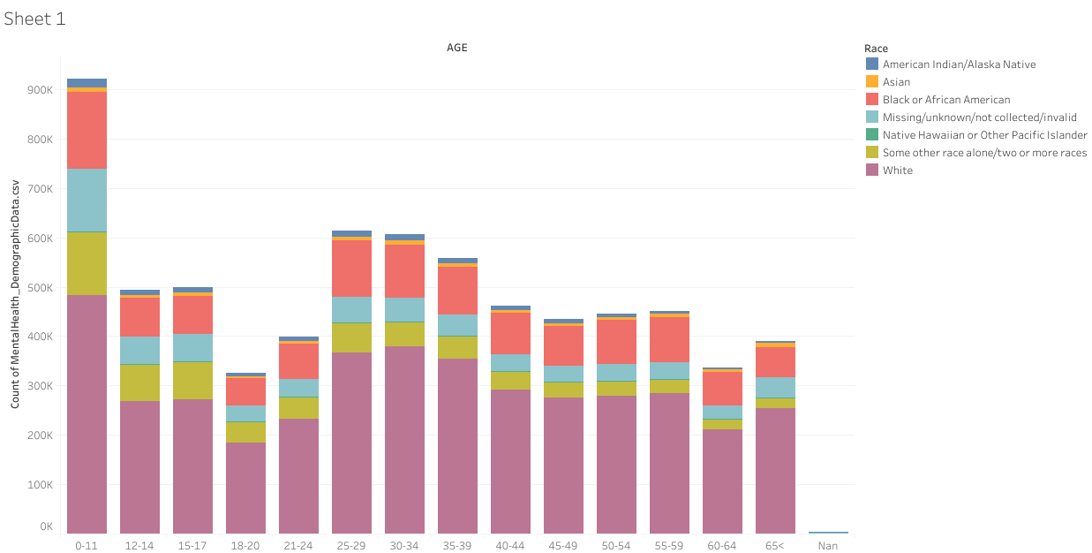

Slide 15
Analysis - Findings

Slide 16
Machine Learning 1: Supervised Logistic Regression
Our first model was Scikit-Learn’s built-in supervised logistic regression
The model ran in a few seconds and produced a testing accuracy score of 0.813

Slide 17
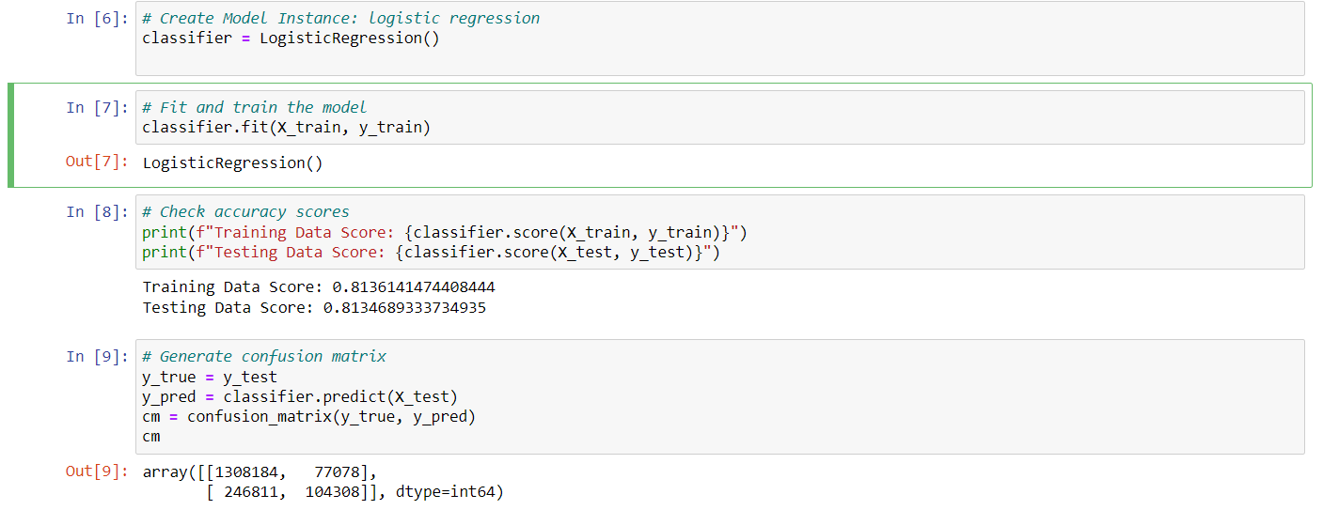
Output and confusion matrix from the logistic regression model

Slide 18
Machine Learning 2: Random Forest
Next, we tried a random forest classifier with 100 estimators
This model took a bit longer to run than the logistic regression
The testing output produced an accuracy score of 0.752
Because this model is both slower and less accurate than the original regression, we would not recommend using it to predict anxiety diagnoses

Slide 19
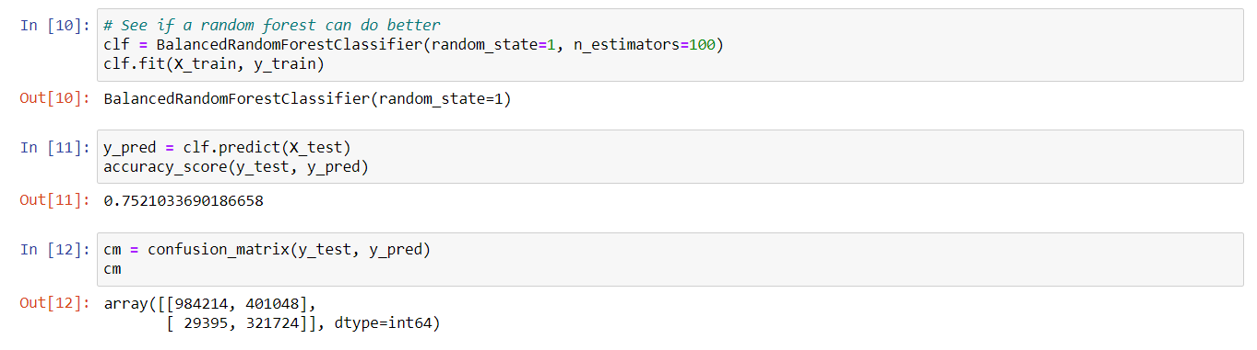
Random forest classifier outcomes

Slide 20
Machine Learning 3: Neural Network
Lastly, we evaluated a deep learning model with two hidden layers of 10 neurons each
The first epoch of the model tested at an accuracy score of 0.830
Subsequent epochs did produce a slight upward trend in accuracy, but the accuracy scores stabilized between 0.833 and 0.834
Each epoch took approximately five minutes, so training the model beyond the first epoch quickly produced diminishing returns for a considerable time investment

Slide 21
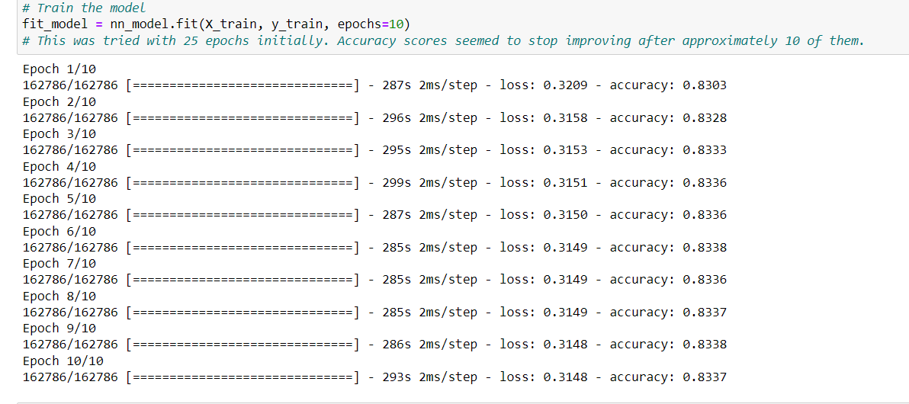
Neural network model run time and accuracy for each epoch

